Slide 1
Course Project
Operating Systems
Module 5 Network Configuration

Slide 2
Rubric
Activity | Requirement(s) | Points
Discover host IP configurations | Answer four questions Take a screen capture | 20
Manage network interfaces | Answer two questions | 20
User network utilities | Take a screen capture | 20

Slide 3
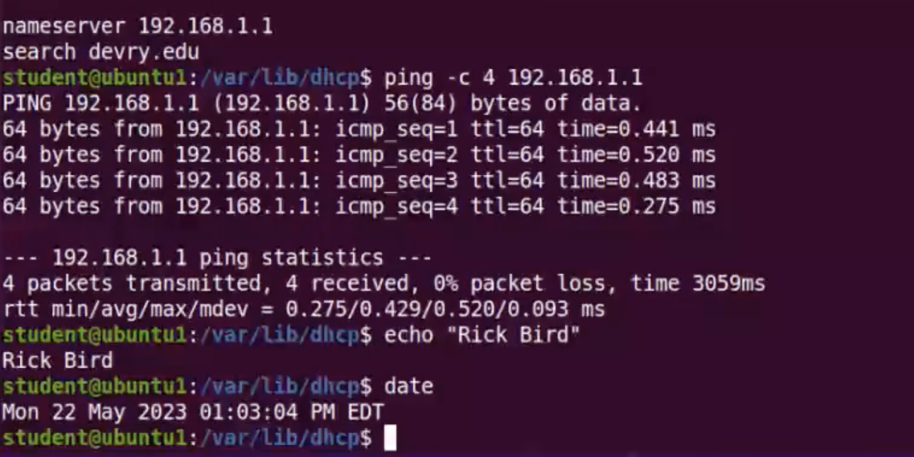
Discover host IP configurations
1. What is the IP address of your Ubuntu machine?
Answer here:
192.168.1.107
2. What is the IP address of its default gateway?
Answer here:
192.168.1.1
3. What is the IP address of its DHCP server?
Answer here:
192.168.1.1
4. What is the IP address of its DNS server?
Answer here:
192.168.1.1
Take a screen capture of the output in Step 12.

Slide 4
Manage network interfaces
1. Which DHCP message is shown in the output of the sudo dhclient –v –r ens33 command?
Answer here: DHCPRELEASE
2. Which four DHCP messages are shown in the output of the sudo dhclient –v ens33 command?
Answer here:
DHCDISCOVER
DHCREQUEST
DHCOFFER
DHCREQUEST

Slide 5
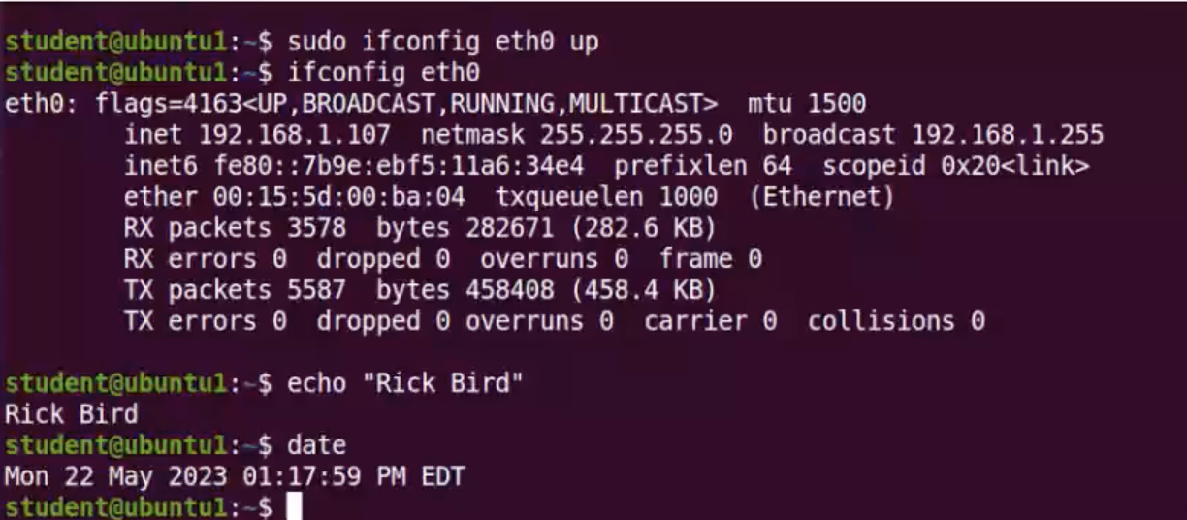
Use network utilities
Take a screen capture of the output in Step 7 and Step 8.

